Slide 1
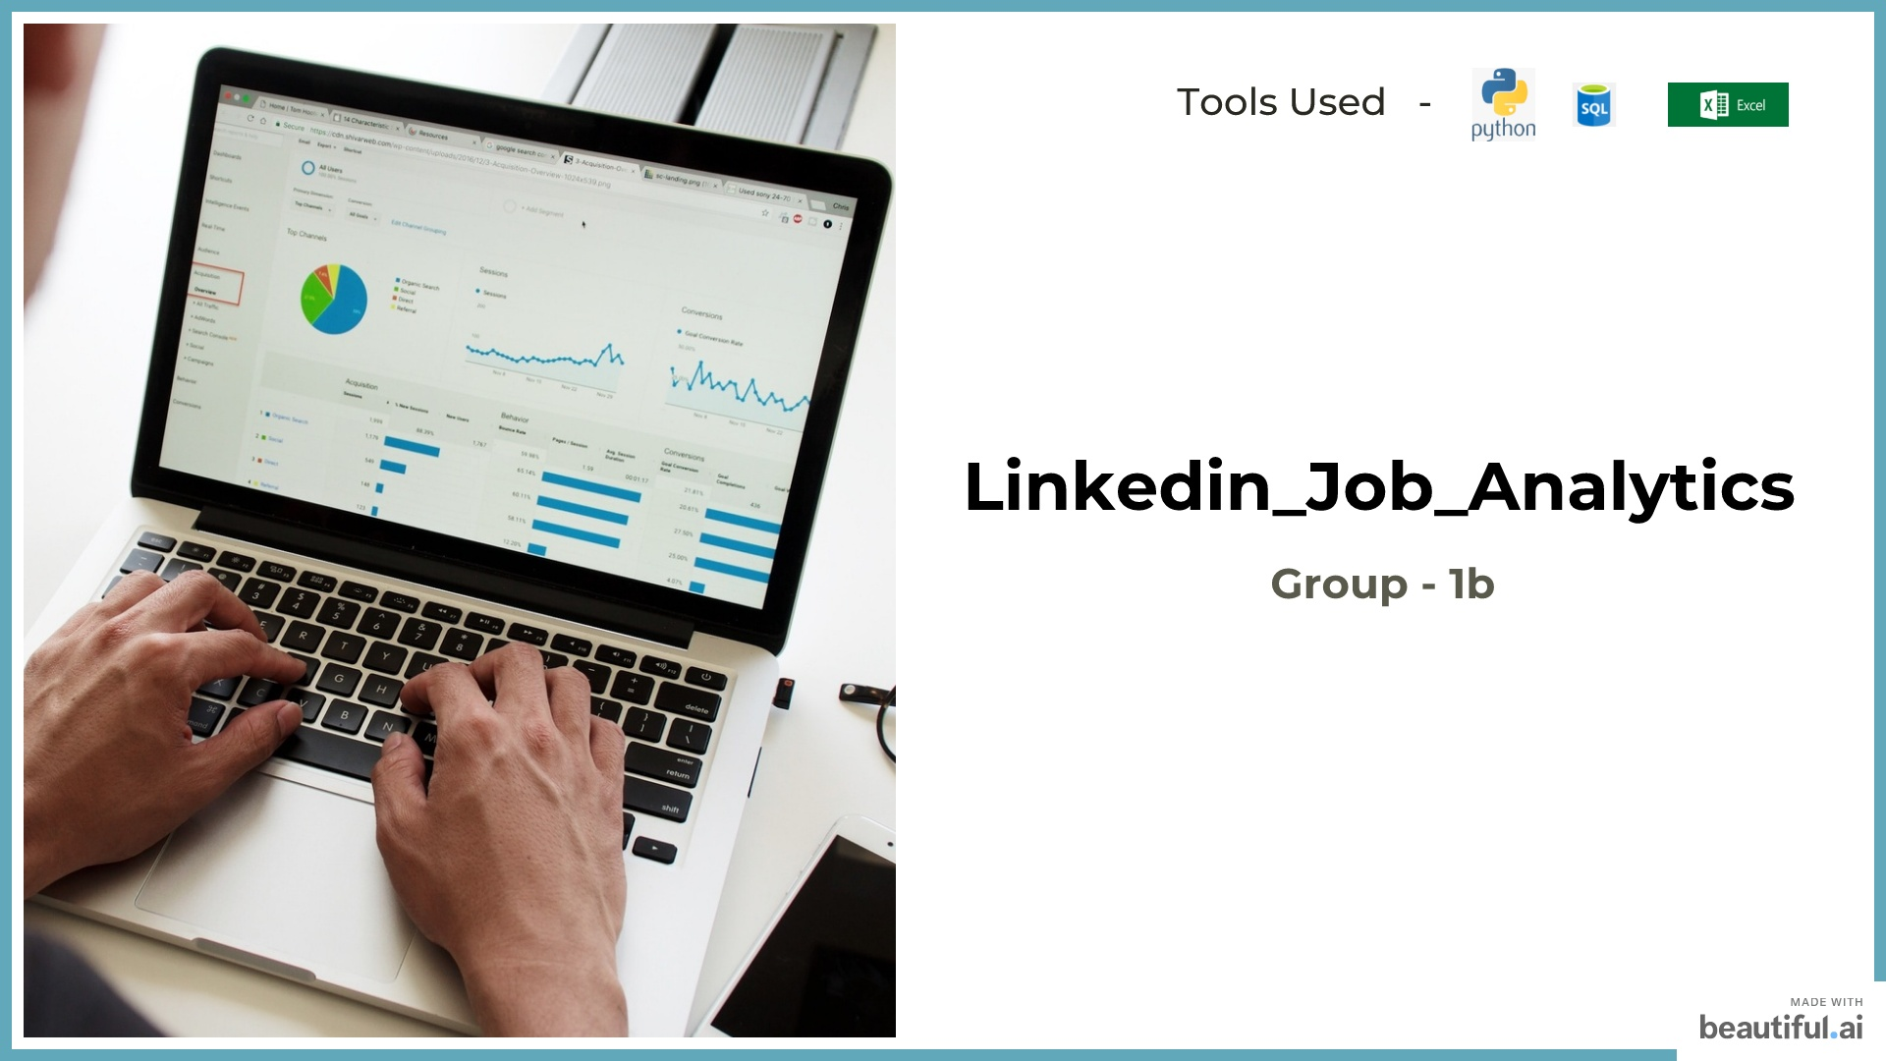



Slide 2
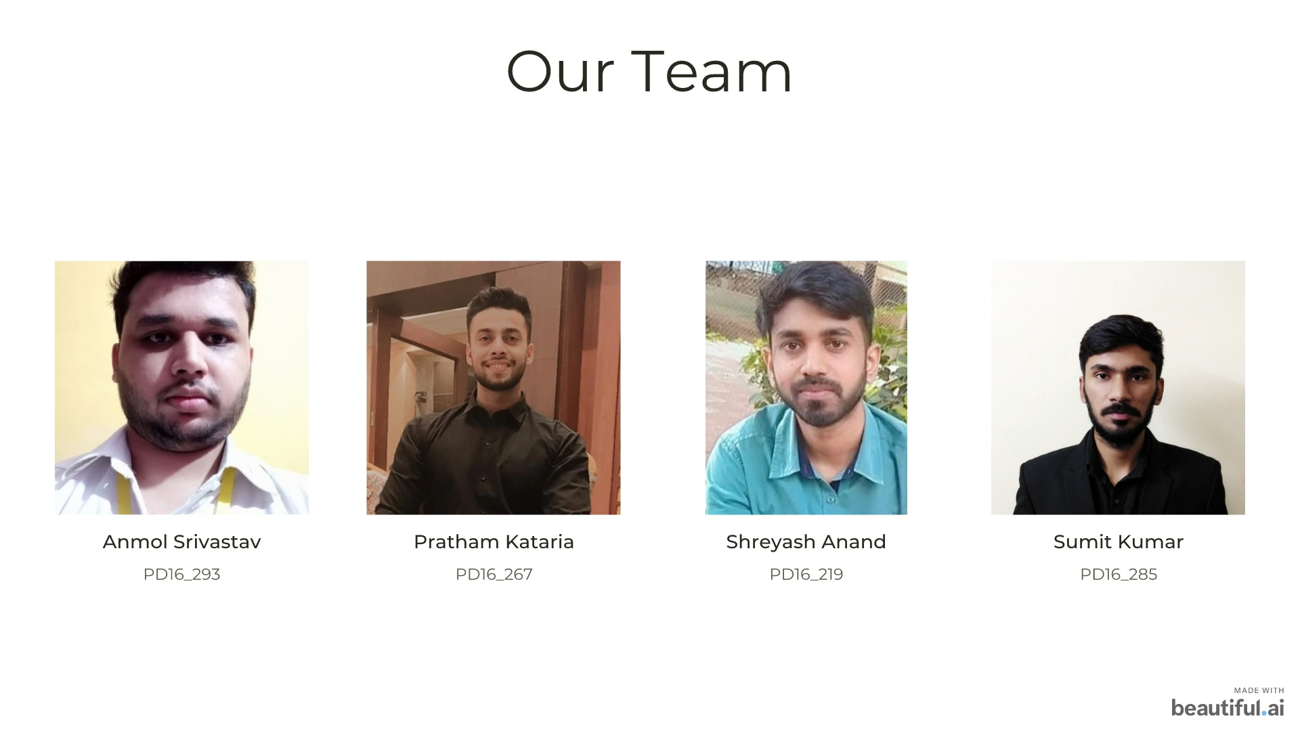



Slide 3
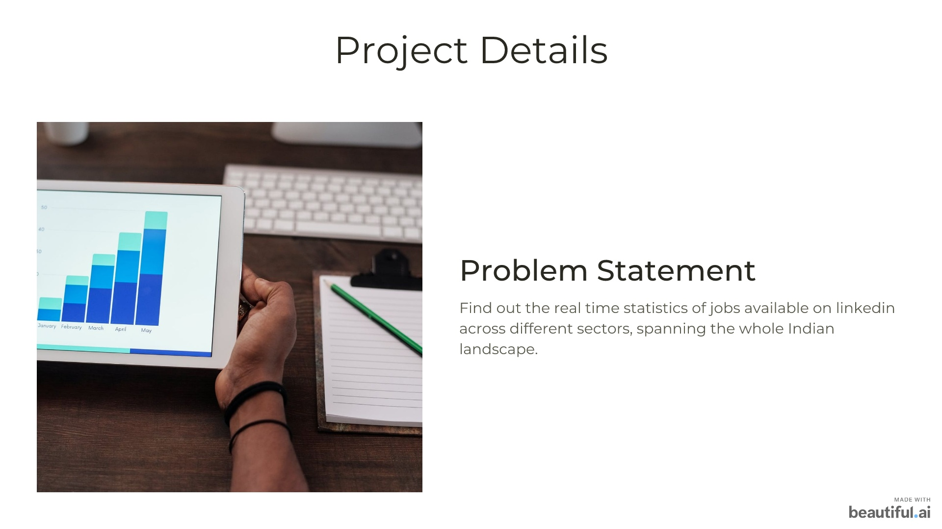


Slide 4
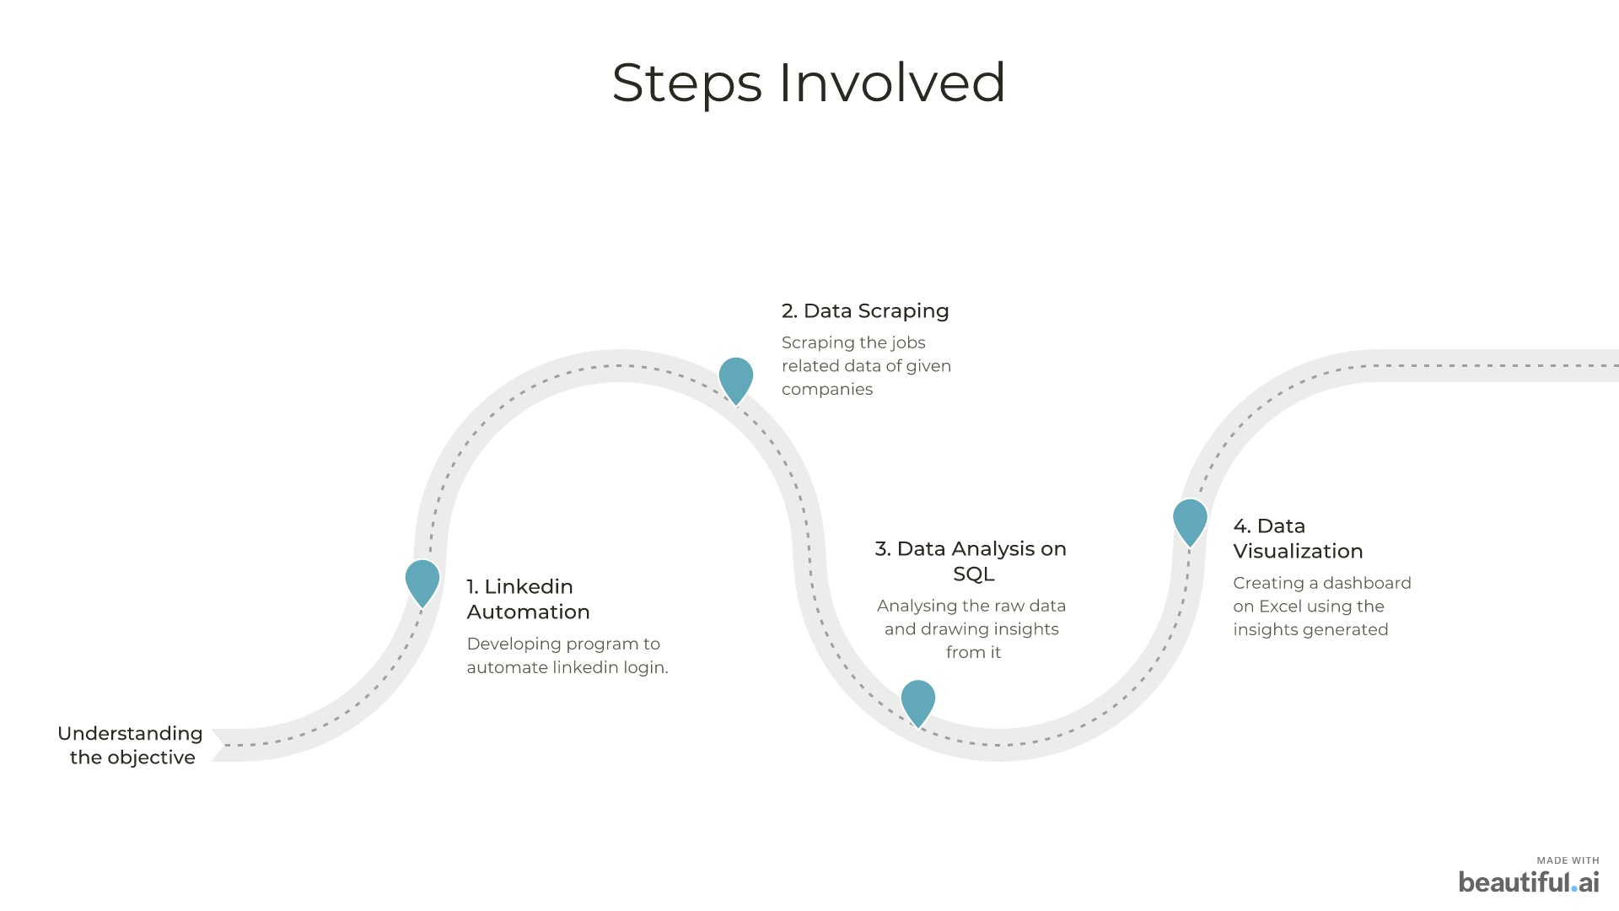


Slide 5
Dataset created after Web Scraping
Table 1(Job) | Table 2(Company) | Table 3(Details)
Job_id | Company_id | Detail_id
Company_id | Company | Involvement
Location | Industry | Level
Job_title | Employees | Total_applicants
Detail_id | Followers

Slide 6
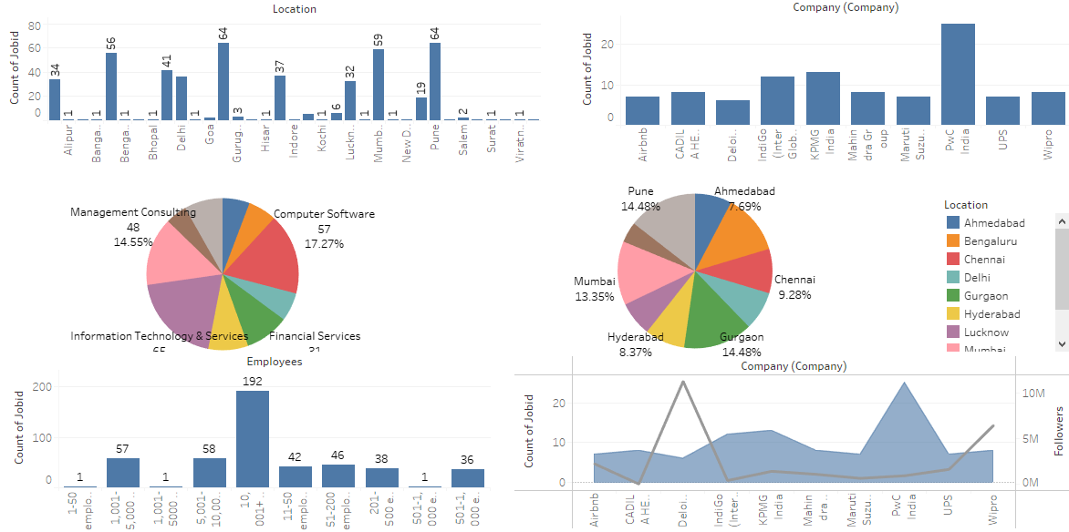

Slide 7
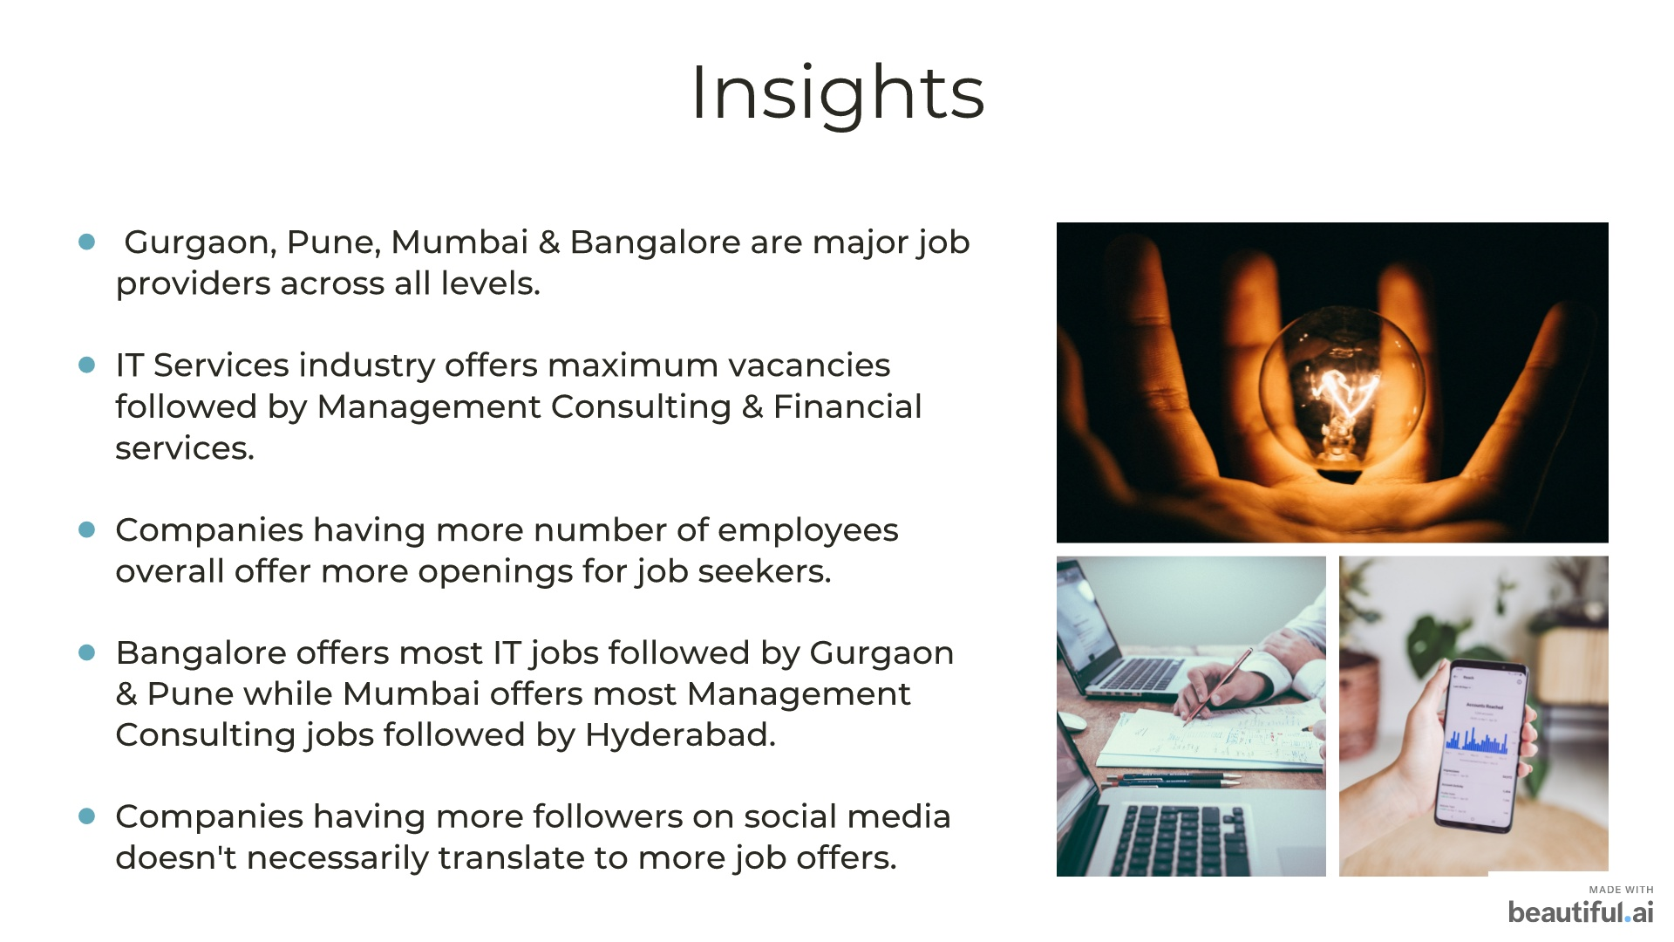


Slide 8
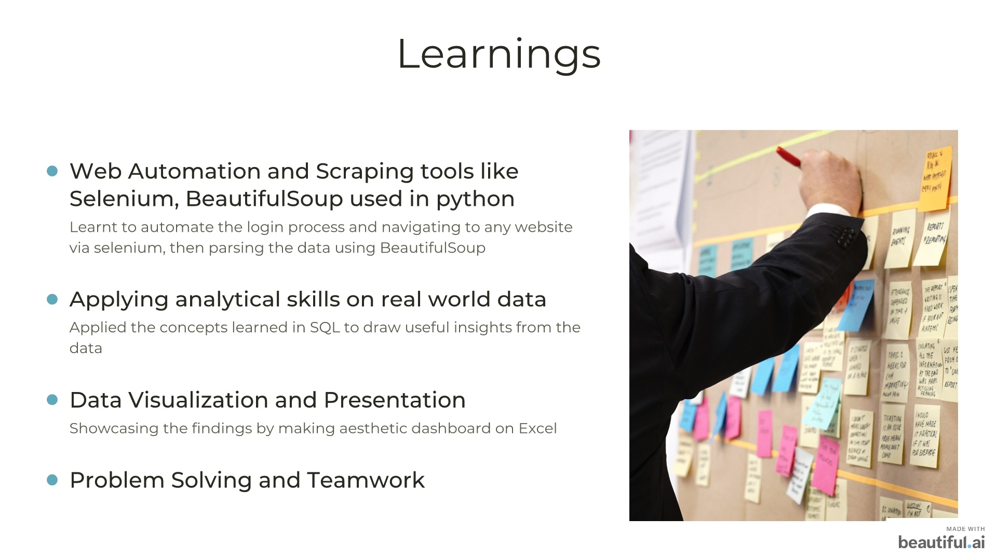


Slide 9



